Slide 1
Quarter 2 -
Power of Persuasion
Persuasive Speeches, Dramatic Scene, & Independent Novels

Slide 2
Bell Ringer - October 26 & 27
Read your independent book for 15 minutes
Answer this question by the end of the week:
Describe one important event in the book and explain why it is significant to the story (the plot, characters, or the idea of the book).

Slide 3
Write this in your notebooks...
Reminder on procedures for turning in assignments:
Read directions
Don’t turn in incomplete assignments
Late assignments will be accepted, but your professionalism grade will be affected (up to a certain point).
Copy things correctly.
Re-attempting a standard will mean completing a new assignment.

Slide 4
SOAPSTone for persuasive speech
Create SOAPSTone for own speech - choose an issue that warrants change
Speaker - your role as the speaker in this piece (concerned citizen, student, etc.)
Occasion - The circumstances prompting this piece
Audience - Who are you addressing?
Purpose - What do you want to accomplish?
Subject - The topic of your persuasive speech
Tone - Your attitude towards the issue and the opposition. How will your diction convey that attitude?

Slide 5
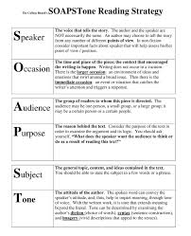
Bell Ringer - November 2 & 4
Select a contemporary issue for your speech
Revisit your SOAPSTone and finish
Speaker - your role as the speaker in this piece (concerned citizen, student, etc.)
Occasion - The circumstances prompting this piece
Audience - Who are you addressing?
Purpose - What do you want to accomplish?
Subject - The topic of your persuasive speech
Tone - Your attitude towards the issue and the opposition. How will your diction convey that attitude?
3. Write down everything you know about the Civil War

Slide 6
Learning Targets
I can...
Analyze the rhetorical devices used in a seminal United States document
Adapt speech for a particular context and task

Slide 7
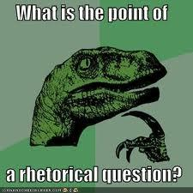
Rhetorical Devices -
Are literary devices (such as metaphors, allusions, analogy, et.c) that enhance the message and/or create an effect. In Lincoln’s speech, be prepared to see devices such as parallel structure, alliteration, and anaphora.
Find the definitions for:
Parallel Structure
Alliteration
Anaphora

Slide 8
Dissecting a Famous Speech - Abraham Lincoln - 1865
With a partner, share the list of details you made referencing the Civil War.
As you read, study the words spoken by President Lincoln one month before the end of the Civil War.
The use of parallel structure has a powerful effect on a written and spoken message. Identify the examples of parallelism, alliteration, and anaphora at work in the speech.
Read aloud - using emphasis and inflection.

Slide 9
Bell Ringer - November 5
Use the ACT word of the day in a paragraph

Slide 10
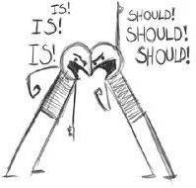
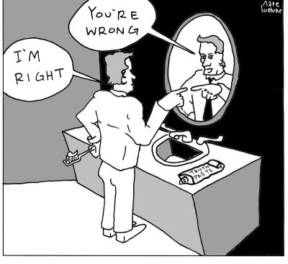
I can...
Analyze the structure of an argumentative text.
Organize and write a persuasive speech.

Slide 11
Structure of an Argument
CLAIM - acknowledges the point of an argument
SUPPORT - uses logical reasoning, relevant evidence, and accurate and credible sources.
Demonstrates understanding of the topic in this section
COUNTERCLAIM - Acknowledges the opposing point of view and offers reasons and evidence that reject the counterclaim.
CONCLUSION - offers a CALL TO ACTION that asks the audience to change their minds or actions to support the claim

Slide 12
Difference Between Anaphora & Parallelism
What is the difference between Anaphora and Parallelism?
• In anaphora, repetition of same words is seen whereas, in parallelism, exact words are not repeated, but words or phrases identical in meaning, or similar in structure or sound are used.
• Writer repeats a word or phrase in the beginning of every clause in a sentence in anaphora to make it clear to the reader.
• Parallelism lends balance as well as rhythm to the sentence while allowing the writer to express the centrality of the idea.
• Both anaphora and parallelism are used as figures of repetition by writers for creative writing.

Slide 13
Further clarification...
Anaphora - repetition of words ****Repeats***
Parallelism/Parallel Structure - repetition of grammatical structure ***Makes things equal***
“Of the people, by the people, for the people”
Parallelism
“Alice ran into the room, into the garden, and into our hearts.”
“To err is human; to forgive divine.”
“Flying is fast, comfortable, and safe”
Parallel Structure
“I will fight on the beaches, I will fight in the towns…”
Parallel Structure & Anaphora

Slide 14
Mini-Debate Format
Team A Speaker 1 -- 2 minute limit
Team B Speaker 1 -- 2 minute limit
Timeout – 1 minute Crossfire (between A1 & B1) 2 minute limit
Team A Speaker 2 -- 2 minute limit
Team B Speaker 2 -- 2 minute limit
Timeout – 1 minute Crossfire (between A2 & B2) 2 minute limit
Timeout – 2 minutes
A1 summary -- 1 minute limit
B1 summary -- 1 minute limit
Grand Crossfire (all speakers) -- 3 minute limit
Timeout – 2 minutes
A2 Last Shot -- 1 minute limit
B2 Last Shot -- 1 minute limit

Slide 15
Bell Ringer - November 9 & 10, 2015
You have 7 minutes to complete this task
Clarifications on Parallelism vs. Anaphora
Anaphora = REPETITION at the beginning of a sentence(s) or phrase(s).
Parallelism = PATTERN of words that create a rhythm & flow - showing ideas are all of equal importance
Does this sentence display parallelism? If not, adjust so it is parallel:
Mary likes hiking, swimming, and bicycling.
Mary likes hiking, swimming, and to ride a bicycle.
The production manager was asked to write his report quickly, accurately, and in a detailed manner.
Mary likes to hike, to swim, and to ride a bicycle.
Mary likes to hike, swim, and ride a bicycle.
The coach told the players that they should get a lot of sleep, that they should not eat too much, and to do some warm-up exercises before the game.
The salesman expected that he would present his product at the meeting, that there would be time for him to show his slide presentation, and that questions would be asked by prospective buyers.
The dictionary can be used to find these: word meanings,pronunciations, correct spellings, and looking up irregular verbs.

Slide 16
Are these parallel?
"You can fool all the people some of the time, and some of the people all the time, but you cannot fool all the people all the time." - Abraham Lincoln
"Ask not what your country can do for you; ask what you can do for your country." - John F. Kennedy
"We are not satisfied, and we will not be satisfied until justice rolls down like waters and righteousness like a mighty stream." - Rev. Martin Luther King, Jr.
Working on tall bridges requires tremendous balance, amazing agility, and will create an eventual lack of fear.
The doctor has the responsibility of providing the examinations and to review the medical history of the employees.
In assembling the basketball team, we looked for players whose style of play was physical, whose backgrounds were impressive, and whose potential was boundless.

Slide 17
What rhetorical device is used here?

Slide 18
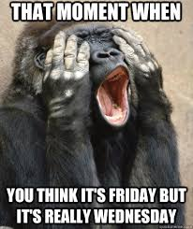
Bell Ringer -
November 11, 2015
Grab a laptop and log on (if they are here...if not, use your phone)
There is a list in front of you called, “List of Rhetorical Devices.”
You are working with the people in your table team.
You will be researching 2 of these devices and presenting them to the class.
Sign up for the desired devices on the front whiteboard.
Be ready to present at 1:05pm.

Slide 19
Goal of the Persuasive Speeches
The effect should be to persuade for change.
The persuasive essay, more often uses passion and emotion in an attempt to sway the reader’s loyalties. Opposing views are often acknowledged here, but aren’t analyzed.
Opinions are blended with facts, all in an attempt to convince the reader that the writer is “right.”
Since the writer is communicating directly to a person, group, or organization, it’s common to use first-person (I) and second-person (you) point of view.

Slide 20
Rhetorical Appeals
Pathos
Ethos
Logos

Slide 21
Time to get started...
1. Pick a topic of interest. (What do you want?)
2. Choose a side to “fight” for.
3. Start writing.

Slide 22
Bell Ringer - November 13, 2014
Notes to write in your notebook:
THERE - THEIR - or - THEY’RE
Rule: The word they’re is always a contraction. Use it only when you can substitute they are.
Rule: The word their is always a pronoun. Use it to show ownership.
Rule: The word there is used as an adverb or pronoun. It is used to show a place or a position, to tell of the existence of something, or when the verb comes before the subject in a sentence.

Slide 23
Just because...
https://www.youtube.com/watch?v=8t8jo4cMGIU
https://www.youtube.com/watch?v=qJK1yMVddpg

Slide 24
Gettysburg Address - Abraham Lincoln
Four score and seven years ago our fathers brought forth on this continent, a new nation, conceived in Liberty, and dedicated to the proposition that all men are created equal.
Now we are engaged in a great civil war, testing whether that nation, or any nation so conceived and so dedicated, can long endure. We are met on a great battle-field of that war. We have come to dedicate a portion of that field, as a final resting place for those who here gave their lives that that nation might live. It is altogether fitting and proper that we should do this.
But, in a larger sense, we can not dedicate -- we can not consecrate -- we can not hallow -- this ground. The brave men, living and dead, who struggled here, have consecrated it, far above our poor power to add or detract. The world will little note, nor long remember what we say here, but it can never forget what they did here. It is for us the living, rather, to be dedicated here to the unfinished work which they who fought here have thus far so nobly advanced. It is rather for us to be here dedicated to the great task remaining before us -- that from these honored dead we take increased devotion to that cause for which they gave the last full measure of devotion -- that we here highly resolve that these dead shall not have died in vain -- that this nation, under God, shall have a new birth of freedom -- and that government of the people, by the people, for the people, shall not perish from the earth.

