Slide 1
Of Mice and Men
John Steinbeck

Slide 2
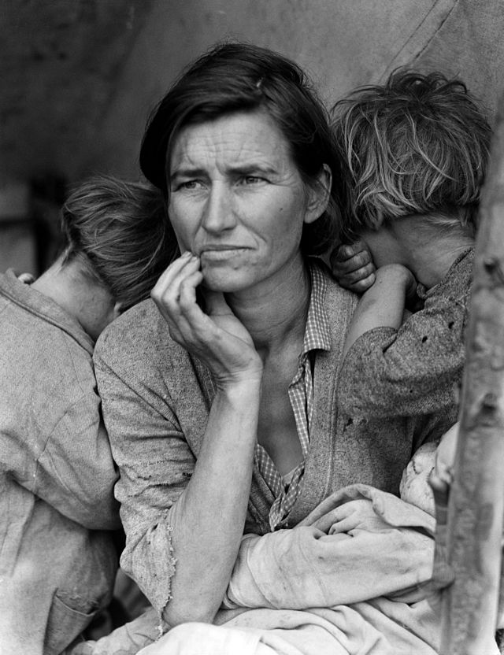
Photographs from the Great Depression For each picture, write down a sentence or two on your reactions to the picture. How does it make you feel? What do you notice? What does it make you think of?

Slide 3
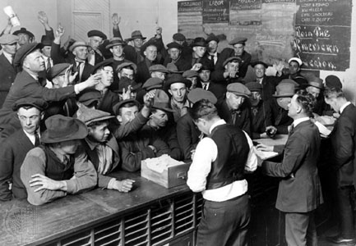

Slide 4
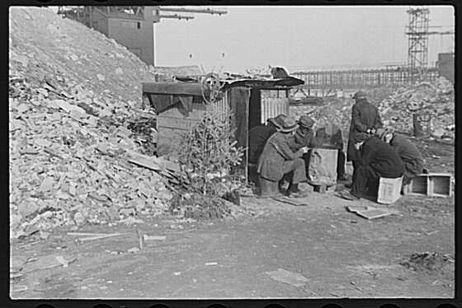

Slide 5
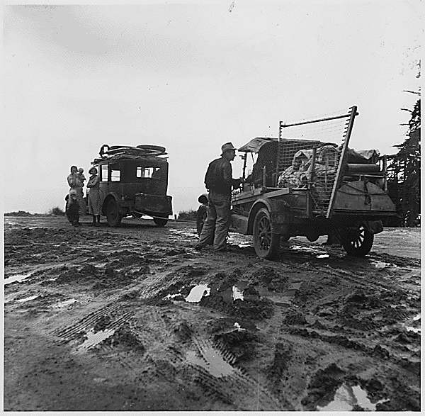

Slide 6
Great Depression Video
Video

Slide 7
The Great Depression Essential Facts
We don’t really know why it happened…
Lasted from 1929-1940’s
Began in 1929 with the stock market crash
Millions were left homeless and jobless
Often there would be 1000+ people applying for one job
Herbert Hoover was president at the time, then Franklin D. Roosevelt
Roosevelt Created – WPA (Works Progress Administration) & New Deal Programs
Entrance into WWII ended the depression

Slide 8
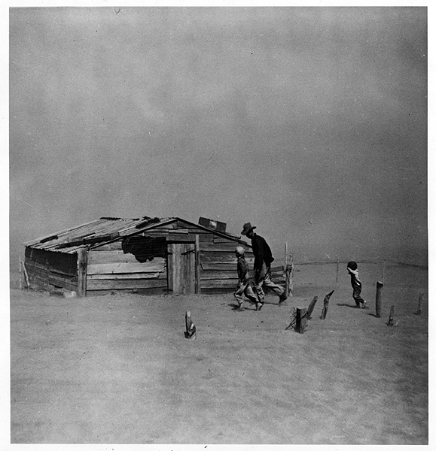
Dust Bowl Essential Facts
Destroyed the Great Plains
1/3 of the U.S., 10 states
Kansas, Oklahoma, Nebraska, Texas, South Dakota, North Dakota, Colorado, Wyoming, Montana, New Mexico
People were forced to leave their lands in search of work, water, and food.
Those who traveled, became known as “Okies” and “Arkies”
California was said to have agricultural jobs so many people went west

Slide 9
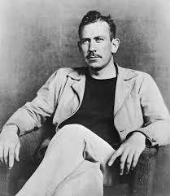
Background on the Author
Famous Novels
Tortilla Flat
In Dubious Battle
Of Mice and Men
The Grapes of Wrath
1902-Born in Salinas, California
Inspiration for much of his work
Worked on a ranch and grew to love the people
Often wrote about the wandering Californians

Slide 10
Of Mice and Men
John Steinbeck

Slide 11
Of Mice and Men in Context Video
Of Mice and Men Video
Of Mice and Men Context Video #2

Slide 12
Discussion Questions (Chapter 1) – pgs 1-16
While I read the passage, write down what jumps out to you about the text as well as answering these questions…
Why does Steinbeck use vivid imagery at the beginning of the novel?
What place might he be describing?
What is the relationship like between George and Lenny?
Find 2 pieces of textual evidence to support this claim.
Why are Lennie’s mice significant? What might they symbolize?
Write down at least 2 ideas.
On the bottom of page 13 George explains about “guys like us.”
How are George and Lennie going to be different from “those guys?”
What separates them from traditional ranch hands?
Provide textual evidence for your reasons.

Slide 13
Sample Answer – Claim, Textual Evidence, Commentary
Lennie and George are best buds; they fight often, but depend on each other greatly. George tends to look out for Lennie almost like a younger sibling, “I want you to stay with me, Lennie. Jesus Christ, somebody’d shoot you for a coyote if you was by yourself. No, you stay with me” (Steinbeck 13). Though George’s words can be viewed as harsh towards his friend, George always keeps Lennie’s best interest in mind and looks out for him all the time.
(Score: 3)

Slide 14
Sample Answer – Score 4
Lennie and George are traveling companions and share a unified dream for the future. Though George is not always kind in his words towards Lennie, he cares about him greatly. George would be lost without Lennie. “I want you to stay with me, Lennie. Jesus Christ, somebody’d shoot you for a coyote if you was by yourself. No, you stay with me,” George said. (Steinbeck 13). Though they fight like siblings, George plays the role of care-taker for Lennie, “I ain’t takin’ it away jus’ for meanness. That mouse ain’t fresh, Lennie; and besides, you’ve broke it pettin; it,” George states(Steinbeck 9). George is constantly evaluating Lennie’s condition, ensuring that he is okay and being taken care of. The companionship that George and Lennie share is what makes their relationship special. It provides both men with hope for the future.

Slide 15
Discussion Questions – Chapter 2 – pgs. 17-37
Power Standard - RL.11.1 Cite strong and thorough textual evidence to support analysis of what the text says explicitly as well as inferences drawn from the text, including determining where the text leaves matters uncertain.
What is the significance of the dogs/puppies in the chapter?
Answer these questions and support your answers with textual evidence and page numbers.
2. What might be the symbolic significance of Carlson wanting to get rid of Candy’s dog?
Answer these questions and support your answers with textual evidence and page numbers.
3. Most all the major characters have been introduced by the end of Chapter 2. Select one character to describe one key trait of their physical appearance and/or personality.
Use textual evidence (plus page numbers) to support your analysis.
Include at least 2 quotes that help describe the character’s personality.

Slide 16
Discussion Questions – Chapter 3 - (pgs. 38-65)
Power Standard - RL.11.1 Cite strong and thorough textual evidence to support analysis of what the text says explicitly as well as inferences drawn from the text, including determining where the text leaves matters uncertain.
Read the passage beginning on page 52 to the top of page 53 ending with a quote by Whit, (“Well, a guy got to have some fun sometime.”).
How do men’s flaws prevent them from achieving the American Dream?
Answer the prompt using the format of claim, text-based evidence, and commentary.

Slide 17
Discussion Questions – Chapter 4 - (pgs. 66-83)
Play Of Mice and Men game

Slide 18
Discussion Questions – Ch. 5 & 6 (pgs. 84-107)
Answer the questions using the Claim, TBE, Commentary format:
Re-read Curley’s wife’s statements from the bottom of page 87 (“Wha’s the matter with me?”) to the middle of page 88 (“If I’d went, I wouldn’t be livin’ like this.”). Evaluate what Curley’s wife is trying to do here.
On pages 100-102, Lennie has hallucinations of his Aunt Clara and a giant rabbit. What do these things represent or what are they symbolic of?

Slide 19
Extra – Alternate Question
Pg 93 – “As happens sometimes a moment settled and hovered and remained for much more than a moment. And sound stopped and movement stopped for much, much more than a moment.” Think about a time in your life when you’ve had a moment like this. Compare your moment with one of the character’s moments in Chapters 5 or 6.

