Slide 1
Bell Ringer (10 minutes) – due at 9:22am
Please grab a syllabus from the front desk. Review and mark any section s that you have questions about.
On a sheet or paper or in your notebook, respond to the following questions:
How do writers use the strategies of definition to define a concept?
What is “the American Dream?”

Slide 2
Learning targets – 1 - Preview the big ideas & vocabulary for the unit 2- Identify and analyze the skills and knowledge necessary for success in writing a definition assignment
August 11th & 12th
Unit on the American Dream

Slide 3
Standards – I can…
W.11.2 – Write informative/explanatory text to examine and convey complex ideas, concepts, and information clearly and accurately.
L.11.3 – Apply knowledge of language to understand how language functions in different contexts, to make effective choices for meaning or style, and to comprehend more fully when reading or listening.

Slide 4
Extended Definitions
Exemplification
Function
Classification
Negation

Slide 5
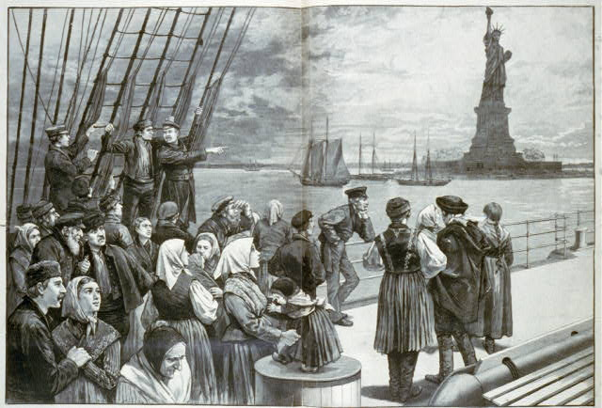

Slide 6
Not like the brazen giant of Greek fame
With conquering limbs astride from land to land;
Here at our sea-washed, sunset gates shall stand
A mighty woman with a torch, whose flame
Is the imprisoned lightning, and her name
Mother of Exiles. From her beacon-hand
Glows world-wide welcome; her mild eyes command
The air-bridged harbor that twin cities frame,
"Keep, ancient lands, your storied pomp!" cries she
With silent lips. "Give me your tired, your poor,
Your huddled masses yearning to breathe free,
The wretched refuse of your teeming shore,
Send these, the homeless, tempest-tossed to me,
I lift my lamp beside the golden door!"
The New Colossus
by Emma Lazarus,
New York City, 1883

Slide 7
On a sheet of paper…
Summarize the main points and big ideas of the poem (RI.11.3).
Then, in a paragraph (or more), compare the illustration to the poem and indicate places where you see connections between the two.
If you haven’t already, write in your notebook/note-taking spot, your American Dream (or just your life dreams).

Slide 8
After viewing the video, revisit your American dream and tell me what challenges may impact your ability to achieve these dreams.

Slide 9
Now…
Condense your “American Dream” into a tweet (exactly 140 characters) that defines your American Dream.
Side note – what are the strategies of definition we studied on Wednesday?

Slide 10
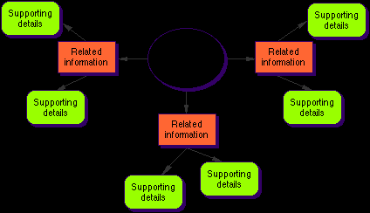
In a concept map…
Put the word “American” in the middle of your bubble map.
Using words, define what it means to be an American.
Using words, answer: “What makes an American unique?”

Slide 11
Bell Ringer – August 17th & 18th
In a written response answer: How do you define yourself?
Use the strategies of definition we covered last week (exemplification, classification, function, & negation).
Be sure to use your homework bubble map to help you with this task – hint hint *_*
(5-7 minutes)

Slide 12
Standards – I can…
W.11.2 – Write informative/explanatory text to examine and convey complex ideas, concepts, and information clearly and accurately.
RI.11.1 – Cite strong and thorough textual evidence to support analysis of the text.

Slide 13
While reading “Growing Up”…
Annotate the text using the methods we detailed out in class last week.
Think about your own personal culture and heritage.
How are your own experiences similar and/or different from Noda’s?
On the back of the essay or a sheet of paper to turn in, answer the question above using textual evidence (citations) from the essay to supplement your answer (RI.11.1).

Slide 14
Bell Ringer – August 19th & 20th
RI.11.3 – Analyze a complex set of ideas or sequence of events and explain how Noda develops over the course of the text.
In your groups, on a poster…map out the author’s main arguments/points. Also, find patterns and connections between those points.
Strategy – discuss first
Then, begin connecting and write those on the poster

Slide 15
Bell Ringer – August 21st & 24th
In your notebooks or the place you keep notes, respond to these prompts:
1. You have unintentionally achieved the proverbial American Dream, you have 2 kids, a white picket fence, a nice house, and a loving spouse. Work on a sort of timeline of how your next 30-50 years turn out with this situation.
2. Talk about a movie, book, or television show in which a family attempts to achieve success in America. What lessons can you learn from their journey and what things could they have done differently? Write your own story of a family attempting the same sort of thing.

Slide 16
Bell Ringer – August 25th
What are the 3 ways you can use someone else’s words? Identify and then define.
A hint – use your smartphones
I can…
*** RI/RL.11.1 – Cite strong and thorough textual evidence to support analysis of what the text says explicitly as well as inferences drawn from the text. ***
Video (https://vimeo.com/13230122)
Think of stories or family experiences that are sacred or important to your family. Write them down in your notebook.

Slide 17
What is an iconic image?
Definitely…not this.

Slide 18
Three elements
of an
iconic image
Widely recognized as representative of a historic event
Image evokes a strong emotional response
The image has been reproduced across a range of media, genres, or topics

Slide 19
Research an Iconic Image
Iwo Jima – Iconic Flag rising

Slide 20
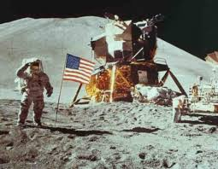
w.11.7 – conduct short and long research projects to answer a question or solve a problem.
I can…

Slide 21
In your groups…
Use your phones to research other iconic American images. Find 5 other images.
We are doing this because these images help capture the essence of what it means to be an American (helps with defining an American).
Group Jobs:
1-2 people research iconic images on their phones
1 person be the time keeper (15 minutes)/Board writer
After you have selected an image, this person write it on the whiteboard so it is not “stolen”
1 person be the scribe (writer)
1-2 people will present the information
***All people must have a job***

Slide 22
Bell Ringer – August 27th
Identify the ingredients you need to make a good hamburger. List them in your notes.
Draw that hamburger in your notes

Slide 23
The Hamburger
Terms to know so that you too can write an effective BODY paragraph:
Topic Sentences (TS) or Claim
Text-Based Evidence (TBE)
Commentary Sentences (CM)
Concluding Sentences (CS)

Slide 24
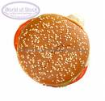
The Topic Sentence The Topic Sentence (TS) or Claim is the top bun of the hamburger
The topic sentence is the first sentence of the paragraph.
It states the main idea and contains an opinion.
(TS=subject + opinion)

Slide 25
Example: Topic Sentence (TS)
In the fairy tale, “The Three Little Pigs,” the third pig was very wise.

Slide 26
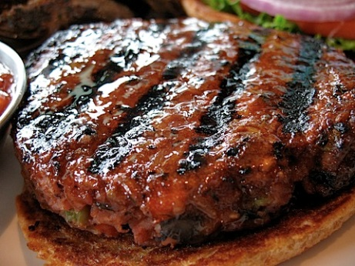
Text-Based Evidence (TBE) are the meat/veggie patty of the hamburger
TBE’s = Support for your TS. (facts, quotations, statistics, examples, paraphrases, etc. from the text or research).
TBE’s can’t be argued with - a TBE is evidence that supports your point
TBE’s can be direct quotations, summaries or paraphrased information

Slide 27
Text-Based Evidence
For example, he remembered his mother’s warning about a wolf, and built his house out of sturdy brick.

Slide 28
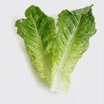
Commentary Commentary Sentences (CM) are the hamburger’s “necessary condiments” - the tomato, cheese, lettuce, pickle – they make it delicious!
CM’s = your analysis, interpretation, inferences, opinion, explanation, or insight.
CM’s = the “so what?”
CM’s = the ideas in your head

Slide 29
Example Commentary Sentences (2 CMs)
The frustrated wolf gave up extremely easily after a half-hearted attempt to blow down the sturdy and intimidating brick house. This proves that the third pig was much more intelligent than his brothers, who were devoured by the wolf.

Slide 30
Step 4: Concluding Sentence A Concluding Sentence (CS) is the bottom bun of the hamburger
A CS wraps up the paragraph. It brings the reader back to the original topic without repeating the same words or summarizing. It makes the paragraph feel complete.

Slide 31
Example Concluding Sentence (CS)
The third pig of the legendary fable outsmarts not only his brothers, but the “big, bad” wolf as well.

Slide 32
Putting it all together!
In the fairy tale, “The Three Little Pigs,” the third pig was very wise. For example, he remembered his mother’s warning about a wolf and built his house out of sturdy brick. The frustrated wolf gave up extremely easily after a half-hearted attempt to blow down the sturdy and intimidating brick house. This proves that the third pig was much more intelligent than his brothers, who were devoured by the wolf. The third pig of the legendary fable outsmarts not only his brothers, but the “big bad” wolf as well.

Slide 33
What is a two-chunk paragraph?
A two-chunk paragraph is an extension of the one chunk paragraph. The student simply adds another burger and more condiments. It looks like this…
TS
CD
CM
CM
CD
CM
CM
CS
Chunk #1
Chunk #2

Slide 34
Bell Ringer – August 30 & 31
Get a computer.
Log-on.
Sign-on to NoRedInk.com.
Pause for directions.

Slide 35
Bell Ringer – August 31
In your notebook, write down 3 (SMART) goals you have regarding your skills in English class.
Specific
Measurable
Attainable
Realistic
Timely (with a deadline)
What do we mean by “American Dream,” and is it still an attainable ideal? Why?
Video

Slide 36
Essential Questions of the Unit
What does it mean to be “American” and how do I see myself in relation to that idea?
What do we mean by “American Dream,” and is it still an attainable ideal?

Slide 37
W.11.2 –
I can…
Write to inform/explain to convey complex ideas, concepts, and information clearly and accurately.

Slide 38
After you have read (name of text) by (name of author(s), now determine (author’s name) purpose. Write an essay that summarizes and analyzes how (he/she) uses rhetoric to advance his purpose. Be sure to cite strong and thorough evidence from the text to support your analysis. Follow the conventions of standard written English.

Slide 39
Writing to Inform
Write a letter to someone in your life to inform them of something.
It can be a letter to a: parent, relative, guardian, friend, Congressman, the President, Dr. Koger, NBA scout, famous musician, school official, college of your choice, ANYONE!
(W.11.2 – Write to inform/explain to convey complex ideas, concepts, and information clearly and accurately)

Slide 40
Take your letter
Share your letter with someone else, have them edit for mistakes, grammar, and possible revisions.
Revise and edit, again.

Slide 41
Bell Ringer – September 3
Use today’s ACT word of the day in a sentence (Quixotic).
In your table teams, discuss Cornell Notes.
What are they?
Why are they useful?
Why do we do them?
Draw a Cornell Note in your notebook or on a sheet of paper.

Slide 42
Bell Ringer – September 4
Turn in your “Letter to my Future Self” into the in-box
Use yesterday’s ACT word of the day in a sentence (quixotic).
Use today’s ACT word of the day in a sentence (beleaguer).
In your table teams, discuss Cornell Notes.
What are they?
Why are they useful?
Why do we do them?
Draw a Cornell Note in your notebook or on a sheet of paper.

Slide 43
Bell Ringer – September 9 & 10
Turn in your “Letter to my Future Self” into the in-box.
Clear off your desks except for some sheets of paper and a writing utensil.
No cell phones out while you are working on the essay.
You will have 45 minutes to write this essay.

Slide 44
Looking for Alaska:
The most important themes in literature are sometimes developed in scenes in which a death or deaths take place. Write a well-organized answer in which you show how a specific death scene helps to illuminate the meaning of the work as a whole. Avoid mere plot summary and identify a theme of the novel.
The Road:
In the novel, a kind of society has replaced what we might recognize as “normal” American society; analyze the social order in McCarthy’s post-apocalyptic America and connect to a theme in the novel.
Into the Wild:
What precisely was McCandless? Use one of Krakauer's terms or invent your own term. Explain this term. Then, choose your term carefully and identify one (or more) of themes displayed throughout the book.
Question # 2 for The Road & Looking for Alaska:
Often in literary works, authors choose a physical object which takes on a special significance in the work and becomes a symbol of something beyond itself. Show how, in the work you read, the author uses a symbol to convey an important meaning. In your answer, focus on the symbol and what it symbolizes. Be sure to discuss how the author uses it to convey a message to readers. You may choose three important symbols from the novel, or you may choose to elaborate on one symbol.
Question #2 for Into the Wild:
“I think that Chris McCandless was bright and ignorant at the same time. He had no common sense, and he had no business going into Alaska with his romantic silliness. He made a lot of mistakes based on arrogance. I don’t admire him at all for his courage nor his noble ideas. Really, I think he was just plain crazy.”
–Shaun Callarman
Explain Callarman’s argument and discuss the extent to which you agree or disagree with his analysis.
Summer Assignment – In-Class Essay

Slide 45
I can…
RL.11.2 – Determine two or more themes or central ideas of the text and analyze their development over the course of the text.
L.11.1 – Demonstrate command of the conventions of standard English grammar and usage when writing.

Slide 46
Bell Ringer – September 11
Use the word “bludgeon” in a sentence that would give clues as to the definition of the word.
Then, write a paragraph discussing patriotism and freedom (honoring Sept. 11)
This ties into our American Dream theme as well
Draw a Circle Map (on the board) in your notes.
(10 minutes for this activity)

Slide 47
I can…
RL.11.2 – Determine two or more themes or central ideas of the text and analyze their development over the course of the text.
RL.11.1 – Cite strong and thorough textual evidence to support analysis of what the text says explicitly as well as inferences drawn from the text.

Slide 48
Theme
List topics.
Write a sentence about the story using –
“The author thinks that….about________.”
Cross out “The author thinks that” and fix sentence.
Theme should be a “life lesson.”
Theme should not be vague.

